Slide 1


Slide 2

According to an IBM study, only 40% of projects meet schedule, budget and quality goals. Further, they found that the biggest barriers to success are people factors.
40%

Slide 3
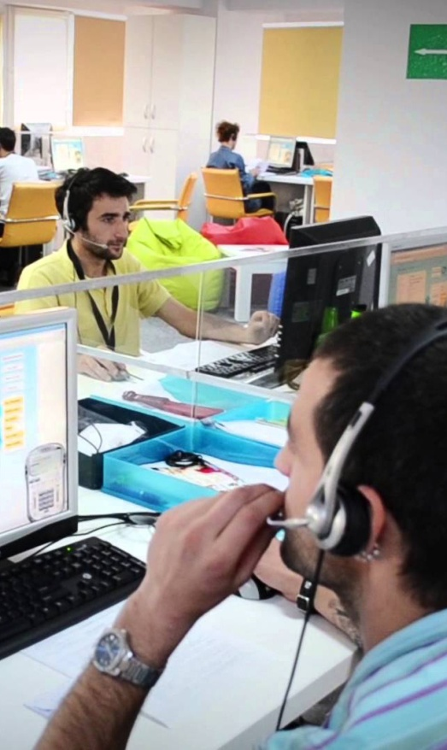


Sri Lankan
Context
BPO
IT
Apparel

Slide 4
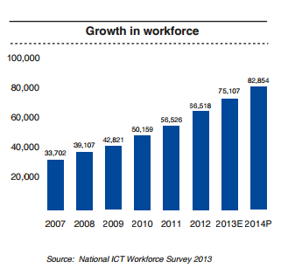
IT Industry
Total employment : Grew from 33,700 in 2007 to an estimated 75,100 employees in 2013
Export Revenue : Grew from USD 213 million in 2007 to an estimated (USD ) 720 million in 2013
Number of companies : Grew from 170 in 2007 to over 220 in 2013
77.5% contribution to total revenue

Slide 5

Apparel Industry
Sri Lanka’s largest export industry since 1986
country’s largest net foreign exchange earner since 1992
provides more than 330,000 direct employment or 5 per cent of country’s total employment in more than 1,060 garment factories

Slide 6


The Problem
Teams are selected by the experience of the senior management
After retirement knowledge transferring process is very difficult by the humans
Consumes lot of time and effort on training a new candidate
Selections are sometimes biased
The right person for the right group will not be selected; as a result of this, employees and employers can be frustrated

Slide 7

Therefore there is need for a BI tool to select the right person for the right job for a project in order to finish the project satisfying:
Scope of the project
Finishing the project within the given period
Meeting the budget and required quality

Slide 8

Introducing
A BI tool to select right People to the right Project by analyzing qualifications, experiences and past performance.

Slide 9

How people Clues works ?
External Data
Human Resource characteristics
Inputs
Project Characteristics
Outputs
Dynamically
selected Team
Data Extraction
Data Cleansing
Data Transformation
Model Building
Model Evaluation

Slide 10

Team Dynamics

Slide 11

What is Team Dynamics?
How people work and interact together in teams
Team dynamics are the hidden strengths and weaknesses that operate in a team between different people or groups and how they affect the way a team reacts, behaves or performs

Slide 12

What is the Challenge in Team Dynamics?
Selecting the right person for the right Job

Slide 13


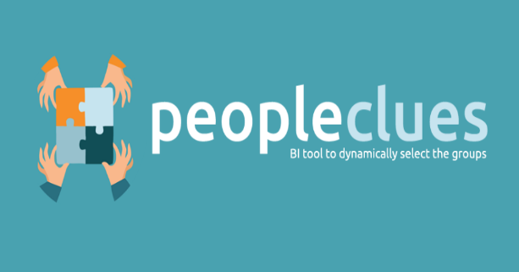




Result-oriented Suggestions
Graphical Reports
Visual Analytics
Interactive Dashboard
Features of People Clues
ETL Tool
Efficient Prediction

Slide 14
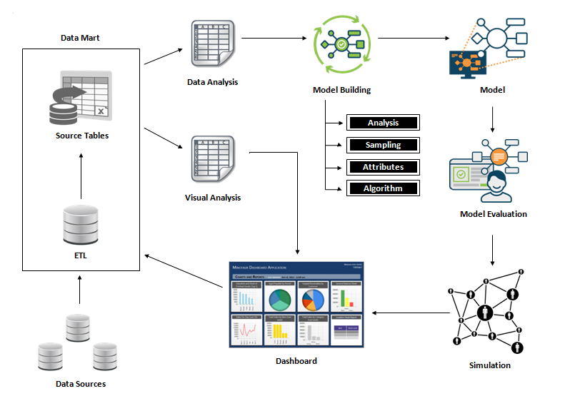
System Architecture

Slide 15
System Hierarchy of People Clues
BI Tool
ETL Tool
Predictive Modeling
Dashboard
Tradition ETL
Hadoop Integrated ETL
IT industry
Apparel Industry

Slide 16






ETL Tool
Source
Extract
Transform
Load

Slide 17
Data Sampling
Algorithm Building
Pre Analysis
Predictive
Model Building

Slide 18

Algorithms
Support Vector Machine
K-Nearest
Neighbors
Naïve Bayes

Slide 19
Predictive Model Evaluation
Classification Table (Confusion Matrix)

Slide 20
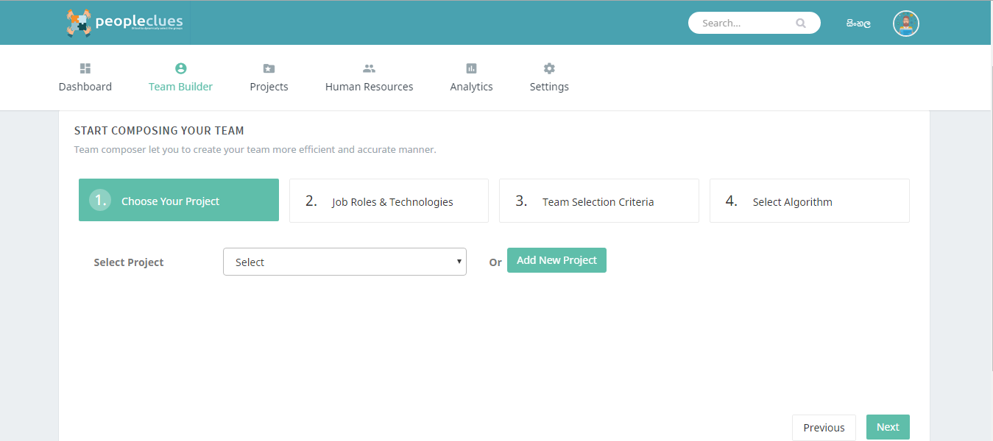
Team Builder Process
Step 1 – Choose your project

Slide 21
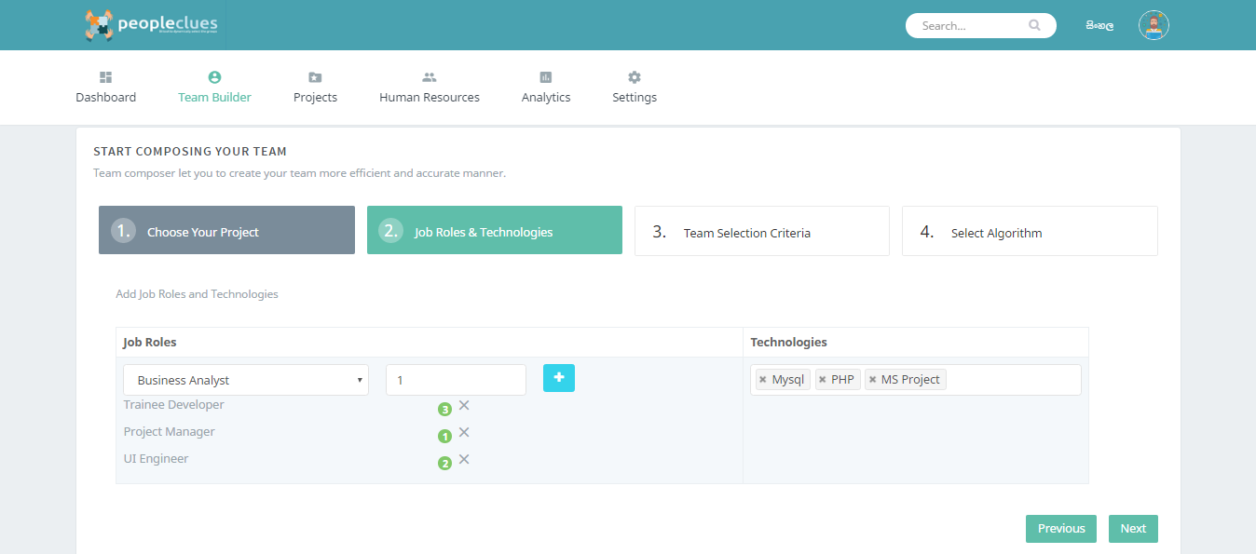
Team Builder Process
Step 2 – Select Job roles and technologies

Slide 22
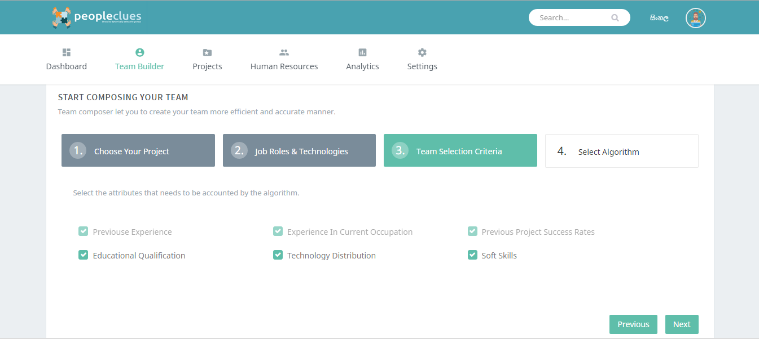
Team Builder Process
Step 3 – Choose Team selection criteria

Slide 23
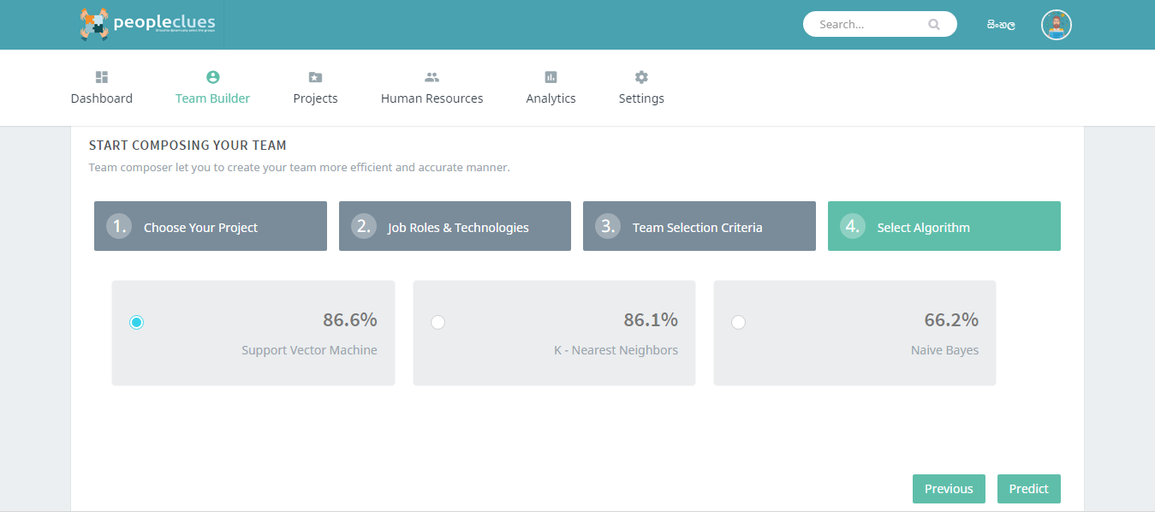
Team Builder Process
Step 4 – Select Algorithm

Slide 24
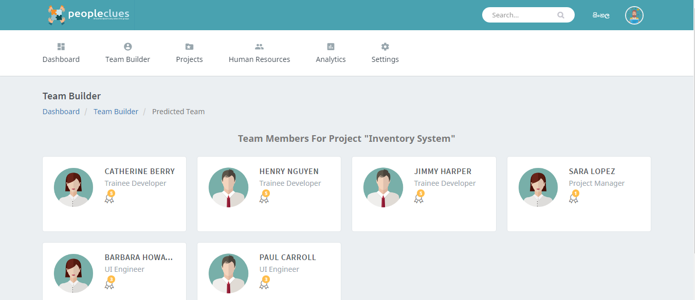
Team Builder Process
Step 5 – Predicted Team

Slide 25
Let’s take a look at People Clues…

Slide 26


Slide 27














Tools and Technologies
ETL | Predictive Modelling | Dashboard Component

Slide 28






Products Available in the Market
$125,600
$ 177,000
$ 225,000
$235,000
$365,000

Slide 29










Problems with existing Tools
High Cost
ETL tools and Predictive
Analytics tools are sold
as separate products
More generalized & doesn’t
fit into local systems
Expert knowledge is needed
Localization is not addressed

Slide 30
Comparison
Features | POP™ | A Team Formation Tool | CATME Team Maker | Oracle BI | Birst | MS Share Point | IBM Cognos | People Clues
ETL Tool (Automated) | ✓ |  | ✓ |  |  |  |  | ✓
Optimal solution | ✓ | ✓ | ✓ | ✓ | ✓ | ✓ | ✓ | ✓
Feasible Solution |  |  |  |  |  |  |  | ✓
Consider about role of each team member | ✓ |  |  |  |  |  |  | ✓
Applicable for many roles |  | ✓ | ✓ | ✓ | ✓ | ✓ | ✓ | ✓
All the users do not need to interact with the system | ✓ |  |  | ✓ | ✓ | ✓ | ✓ | ✓
Visualization of data in an abstract way |  |  |  |  | ✓ | ✓ |  | ✓
Predictive Analytics | ✓ |  | ✓ | ✓ | ✓ | ✓ | ✓ | ✓
Can be customized to local languages |  |  |  |  |  |  |  | ✓

Slide 31


Who gets the benefits ?
Top Management who are trying to earn benefits out of each project
Project Managers who are trying to make the projects successful

Slide 32

Targeted Companies ?
Companies that are working as Teams in Projects

Slide 33
Where the money comes from?
 | Small Scale Companies (Employees <100) | Large Scale Companies (Employees >100)
Complete System | US$ 1000 per annum | US$ 2000 per annum
Free Updates | 6 months | 6 months
No of Users | 2 Licenses | 5 Licenses

Slide 34
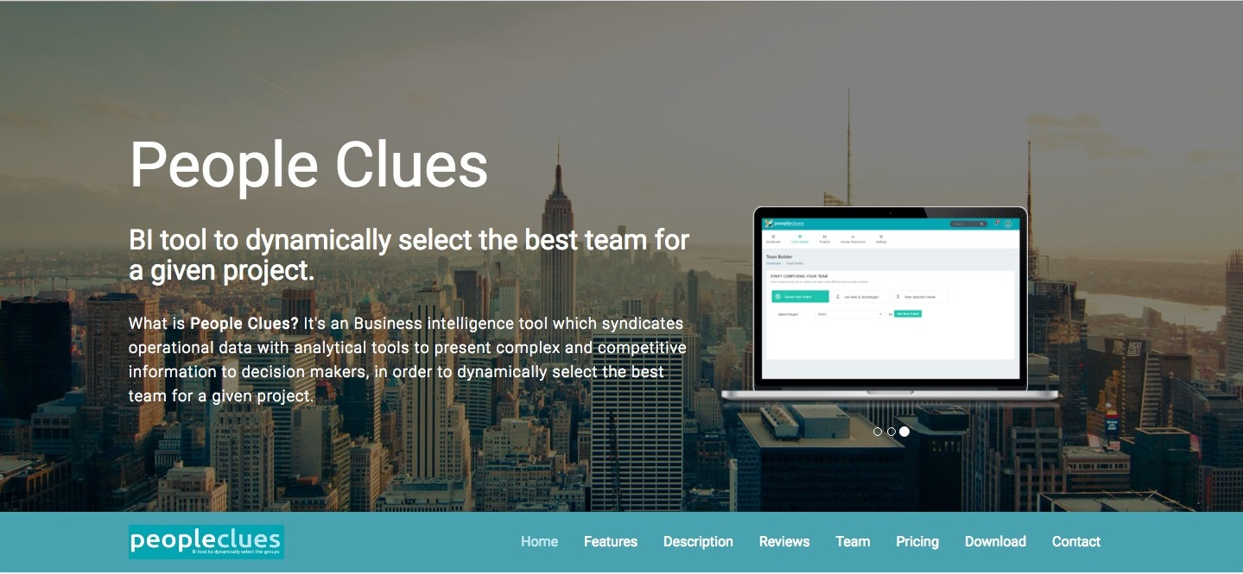
Visit our website at…
http://blinklaboratories.com/

Slide 35

Expertise in People Clues
Industry Recommendation
"People Clues is an innovative product with a greater potential in HR Analytics for any given industry. It has the ability to select most suitable teams through identification of trends and patterns of employee performance, experiences and qualifications.
Roster planning is a common scenario nowadays most human resources information systems are looking into. Differentiation of "People Clues" comes with its analytics engine which identifies the hidden patterns and trends. Not only that but also adapting to the changes in near real time. Going one step further the team has introduced Sinhala and Tamil versions which cater the requirements of SMEs in Sri Lanka whom cannot afford expensive analytics resources but are keen on data driven insights.
Even though the current product is only for the Apparel and IT sectors I could see this can be enhanced and expand it to other sectors specially in manufacturing, financial services, FMCG and hospitality management sector."
Mr.Hansa Perera
Consulting Engineer - Business Analytics at N-Able Private Limited

Slide 36

Expertise in People Clues
Industry Recommendation
"I am Rangika Perera, working for Duo Software as a Senior Manager, Projects and Product Incubation.
As a person more involved in the project management and the product development of the company, my main concern is the efficiency and the productivity of my own teams.
And I would like to recommend the product, the BI tool which I have overlooked, not because it only has the capability to give more insight of the employee’s production data in the organization but also which has the tools to build a collaborative environment and to support the process of team formation. The BI tool has its own algorithms to analyse the past employees data and predicts the outcome of the projects artifact, this will defiantly be a key component will help the project management process.
The BI tool facilitates the Top and the senior managers to process the data in real-time as well as periodically, the BI tools providing with elegant dashboards/widgets and reports in real-time to support their strategic decisions making process.
And more, it’s really impressed me to see the localization built in with the product, which supports Sinhalese and Tamil, which I presume the feature has its own market potential that will defiantly support to market mainly in Asian region.
Overall, I would like to recommend the product and I do believe it has its unique capabilities to compete and prospect in the industry.
"
Mr.Rangika Perera
Senior Manager – Projects and Products Incubation at Duo Software

Slide 37
Provide localized product to every region.
Knowledge base development for the Model Evaluation.
Customization to plug into a Project Management Tool.
Future of People Clues

Slide 38

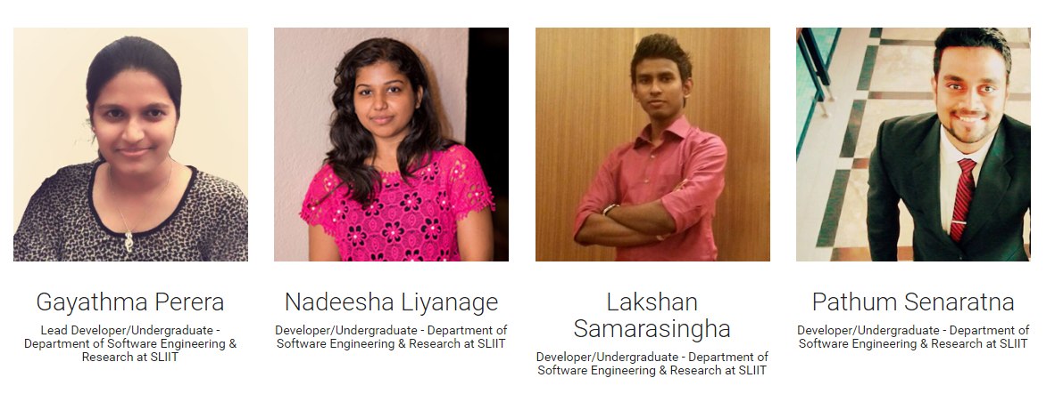
Our Team

Slide 39

Sri Lanka Institute of Information Technology
Thank You!!
Q & A

